Slide 1
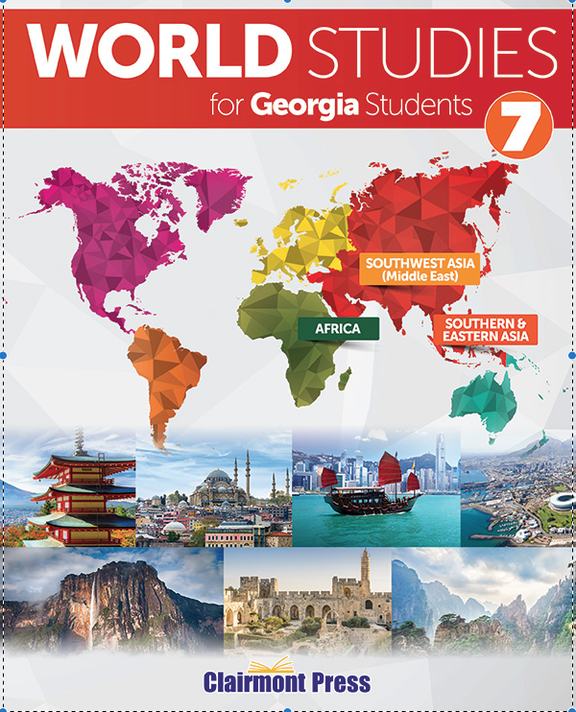
China
Wrap-Up
To play the game, go to the next slide and click on a point value to go to a question.
To go to final Wrap-Up click on Final Wrap-Up at the bottom of the main screen.

Slide 2
Geography
History
Government
Economy
US/China
Vocabulary
100
100
100
100
100
100
200
200
200
200
200
200
300
300
300
300
300
300
400
400
400
400
400
400
500
500
500
500
500
500

Slide 3
Team 1
Team 2
Team 3
Team 4
Team 5
Wager
Wager
Wager
Wager
Wager
Final
Wrap-Up
board

Slide 4
What mountain range forms the southern border of China?

Slide 5
Himalayans
board
score

Slide 6
What two deserts are in China?

Slide 7
Gobi
Taklamakan
board
score

Slide 8
What are 3 environmental issues in China?

Slide 9
Air pollution
Water pollution
Flooding
board
score

Slide 10
What ethnic group makes up the largest group in China?

Slide 11
Han ethnic group
board
score

Slide 12
Why was the population growth rate so slow in the country of China before 2015?

Slide 13
Until 2015, China had a “one-child” policy, meaning couples could only have one child.
board
score

Slide 14
List 3 of the greatest accomplishments or inventions of ancient China.

Slide 15
gunpowder
silk
tea production
compass
papermaking
board
score

Slide 16
Who is credited with the formation of the communist party in China?

Slide 17
Mao Zedong
board
score

Slide 18
What was the cultural revolution?

Slide 19
Mao Zedong encouraged students to leave school and make war on anything in Chinese society that looked like it encouraged class differences.
board
score

Slide 20
What ruler took over as leader of the party after Mao died?

Slide 21
Deng Xiaoping
board
score

Slide 22
What are 3 activities that Deng allowed but Mao was not in favor?

Slide 23
Allowed farmers to own land and make decisions about what crops to grow
Allowed some private ownership of businesses
Opened China to foreign investment and technological advances
board
score

Slide 24
What type of government does China have?

Slide 25
Communist Party
board
score

Slide 26
How is the head of government chosen?

Slide 27
The premier, or head of government, is nominated by the president and approved by the National People’s Congress.
board
score

Slide 28
What are the qualifications for running for office in the congress?

Slide 29
They have to be members of the CCP.
They have to a member of the eight political parties that are allies of CCP.
They have to be a CCP-approved independent candidate.
board
score

Slide 30
What citizen roles does the government decide?

Slide 31
job
education
board
score

Slide 32
What are 3 of the economic challenges China’s government faces?

Slide 33
The need to reduce environmental problems
Looking for newer, cleaner energy sources
Increasing the standard of living
Reducing government corruption
board
score

Slide 34
What type of economy exists in China?

Slide 35
Command Economy
board
score

Slide 36
China is the _______ ________ of goods in the world.

Slide 37
largest exporter
board
score

Slide 38
What are Special Economic Zones?

Slide 39
Special zones established in provinces along the east coast to act as trade centers
board
score

Slide 40
Although rare, what chemical is found in China?

Slide 41
Uranium
board
score

Slide 42
What are two unique items about the Chinese yuan?

Slide 43
It has been used for over 2,000 years.
The first currency to use metal coins and banknotes
board
score

Slide 44
Why does the United States want to have a good relationship with China?

Slide 45
To build trust and increase cooperation, especially in light of concerns for Iran and North Korea
board
score

Slide 46
In November, 2014 what arrangement did President Obama announce?

Slide 47
An arrangement that allowed for extended visas that would allow for longer visits by citizens of one country in the other country
board
score

Slide 48
What are two of the areas the US provides assistance to China?

Slide 49
supporting environmental protection
expanding human rights
aiding the Tibetan communities
addressing threats of pandemic diseases
board
score

Slide 50
Who is China’s largest export market?

Slide 51
United States
board
score

Slide 52
China and the US both work to address threats from Iran and North Korea. What are these threats?

Slide 53
nuclear programs
board
score

Slide 54
Define monsoon season.

Slide 55
A season of heavy rains
board
score

Slide 56
What was the Long March between October 1934-October 1935?

Slide 57
A journey where Mao Zedong and his followers walked nearly 6,000 miles to avoid capture
board
score

Slide 58
What was the Great Leap Forward from 1958-1962?

Slide 59
A program started by Mao Zedong that would help solve agricultural and industrial problems
board
score

Slide 60
Where is the Three Gorges Dam and what does it produce?

Slide 61
Located on the Yangtze River and produces the most hydroelectric power in the world.
board
score

Slide 62
Define acid rain.

Slide 63
Rain that is poisoned by the chemicals in the air, and contains sulfuric and nitric acid which is harmful to plants, animals, and buildings
board
score

Slide 64
Final
Wrap-Up
Make your wager on the scoreboard
Final Question
score

Slide 65
What are China’s Four Modernizations?

Slide 66
Farmers were given more control over what they produce.
Industry shifted from heavy industry to consumer goods.
Factory workers and managers were given more power to make decisions.
Foreign countries were encouraged to do business with China.
board
score

